Slide 1
Lecture 3: Design By Contract with JML (Java Modeling Language)
EC3307:Object & Component technology

Slide 2
Outline
Design by contract (DBC)
Java Modeling Language (JML)
DBC with JML
JML tools – JML compiler (jmlc)

Slide 3
Contracts in Real World
Contracts specify:
Agreements
Obligations and rights
Contracts for buying cars
Clients: give money; receive cars
Dealers: give cars; receive money

Slide 4
Contracts in Software
/** Returns a square root approximation of a non-negative number x.
* @param x A non-negative number.
* @returns A square root approximation of x.
*/
public static double sqrt(double x) { … }
Obligations
Rights
Client
Passes non-negative
number
Gets square
root approximation
Computes and
returns square root
Assumes argument
is non-negative
Implementor

Slide 5
Design by Contract (DBC)
/*@ requires x >= 0.0;
@ ensures (Math.abs(\result * \result - x) <= 0.00001);
@*/
public static double sqrt(double x) { … }
Advantages over informal contracts?
Unambiguous
Machine manipulation

Slide 6
Pre and Postconditions
Definition
A method’s precondition says what must be true to call it.
A method’s normal postcondition says what is true when it returns normally (i.e., without throwing an exception).
A method’s exceptional postcondition says what is true when a method throws an exception.
//@ signals (IllegalArgumentException e) x < 0;

Slide 7
Contracts as Documentation
For each method say:
What it requires (if anything), and
What it ensures.
Contracts are:
More abstract than code,
Not necessarily constructive,
Often machine checkable, so can help with debugging, and
Machine checkable contracts can always be up-to-date.

Slide 8
Abstraction by Specification
A contract can be satisfied in many ways:
E.g., for square root:
Linear search
Binary search
Newton’s method
…
These will have varying non-functional properties
Efficiency
Memory usage
So, a contract abstracts from all these implementations, and thus can change implementations later.

Slide 9
More Advantages of Contracts
Blame assignment
Who is to blame if:
Precondition doesn’t hold?
Postcondition doesn’t hold?
Avoids inefficient defensive checks
//@ requires a != null && (* a is sorted *);
public static int binarySearch(Thing[] a, Thing x) { … }

Slide 10
Modularity of Reasoning
Typical OO code:
…
source.close();
dest.close();
getFile().setLastModified(loc.modTime().getTime());
…
How to understand this code?
Read the code for all methods?
Read the contracts for all methods?

Slide 11
Contracts and Intent
Code makes a poor contract, because can’t separate:
What is intended (contract)
What is an implementation decision
E.g., if the square root gives an approximation good to 3 decimal places, can that be changed in the next release?
By contrast, contracts:
Allow vendors to specify intent,
Allow vendors freedom to change details, and
Tell clients what they can count on.

Slide 12
Outline
Design by contract (DBC)
Java Modeling Language (JML)
DBC with JML
JML tools – JML compiler (jmlc)

Slide 13
JML
What is it?
Stands for “Java Modeling Language”
A formal behavioral interface specification language for Java
Design by contract for Java
Uses Java 1.4 or later
Available from www.jmlspecs.org

Slide 14
Annotations
JML specifications are contained in annotations, which are comments like:
//@ …
or
/*@ …
@ …
@*/
At-signs (@) at the beginning of lines are ignored within annotations.

Slide 15
Outline
Design by contract (DBC)
Java Modeling Language (JML)
DBC with JML
JML tools – JML compiler (jmlc)

Slide 16
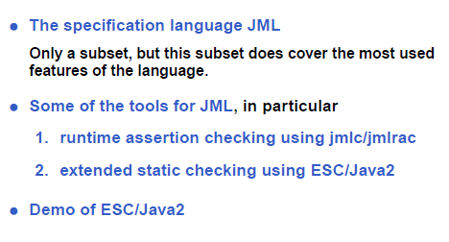
Overview

Slide 17
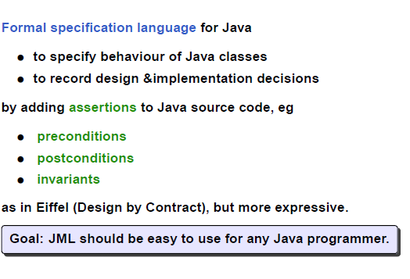
JML

Slide 18
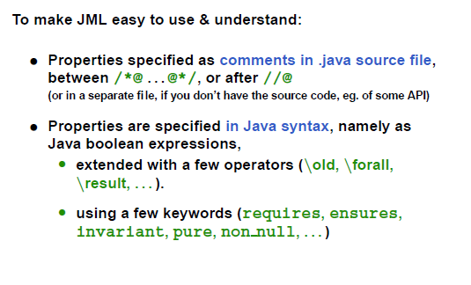
JML

Slide 19
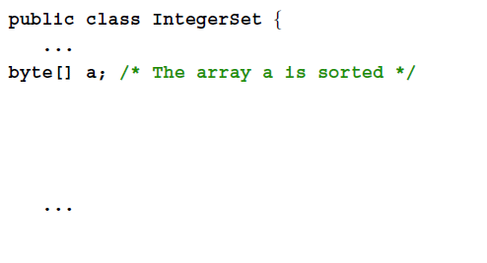
Example JML Specification

Slide 20
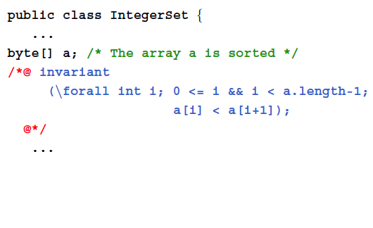
Example JML Specification

Slide 21
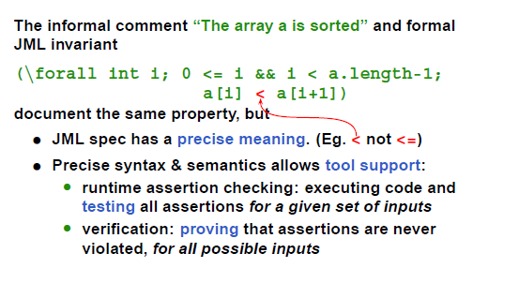
Informal Vs Formal

Slide 22
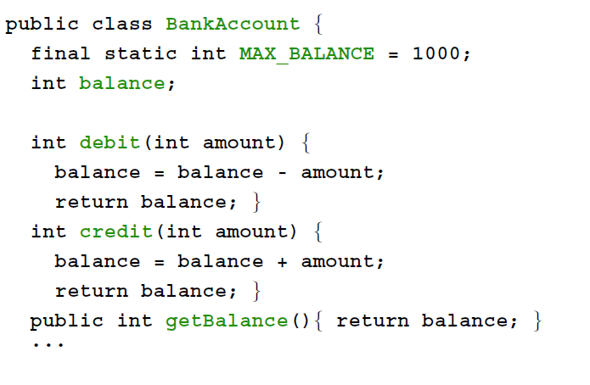
Example

Slide 23
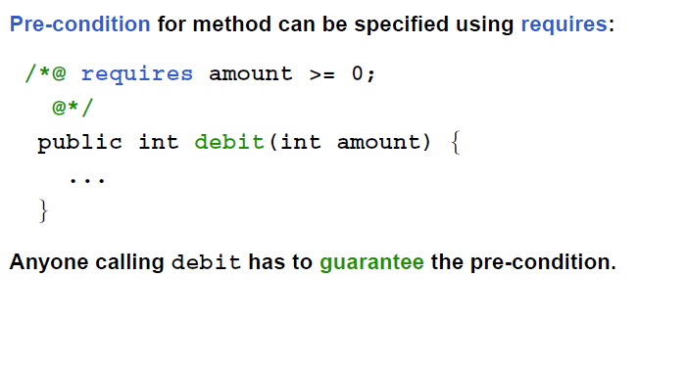
requires

Slide 24
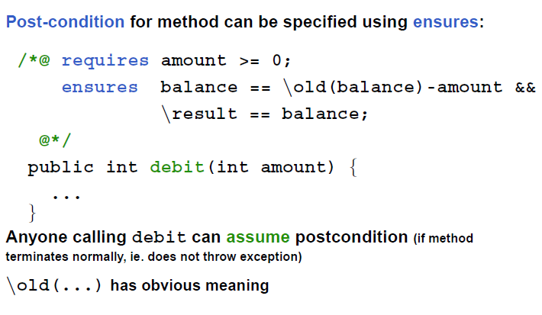
ensures

Slide 25
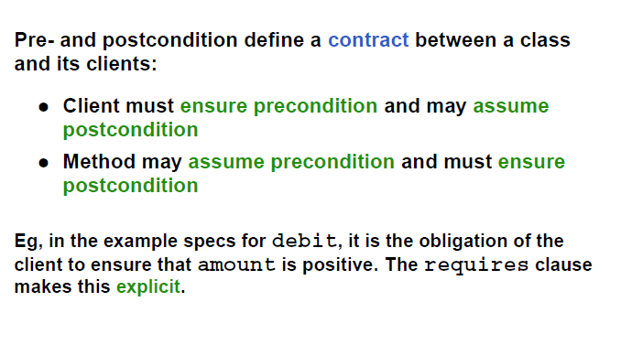
Design By Contract

Slide 26
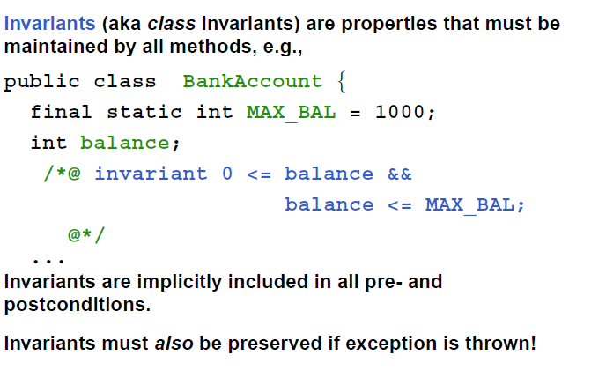
invariant

Slide 27
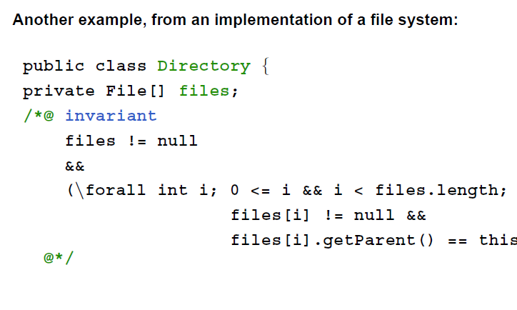
invariant

Slide 28
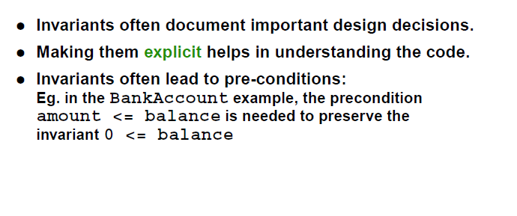
invariants

Slide 29
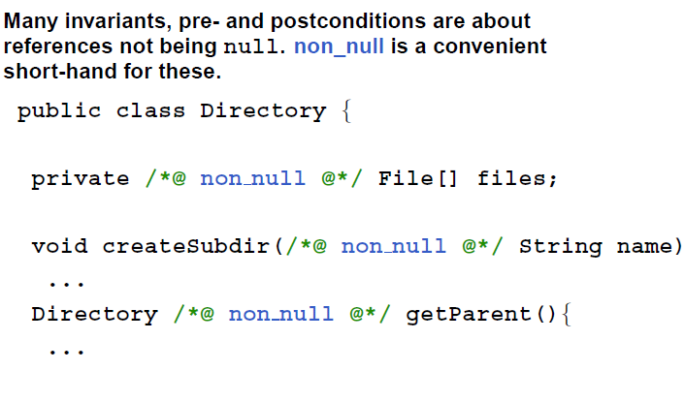
non_null

Slide 30
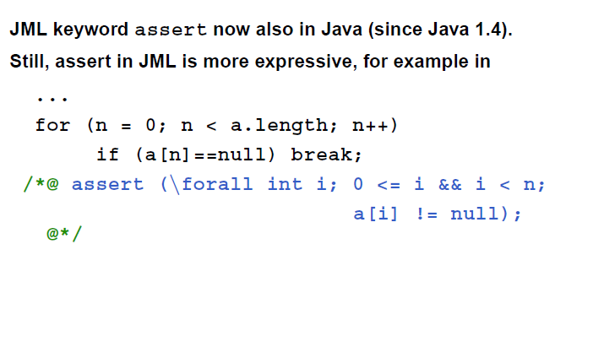
assert

Slide 31
Exceptions
Method has two ways to return
Normal return: the postcondition specified by ensures holds
Exceptional return: an exception is raised and the precondition specified by signals holds

Slide 32
Meaning of Postconditions
normal
(return)
exceptional
(throw)
ensures
kgs >= 0 …
signals (…)
kgs < 0;

Slide 33
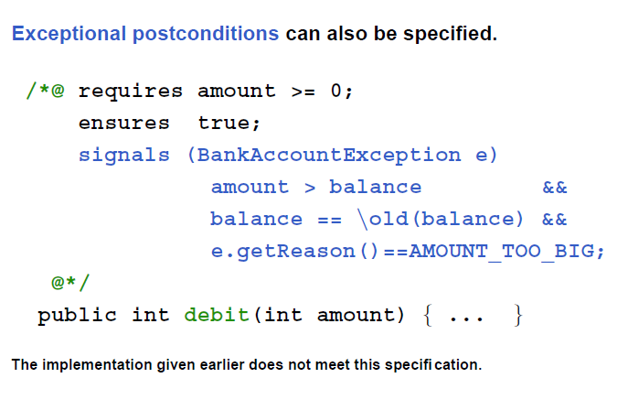
signals

Slide 34
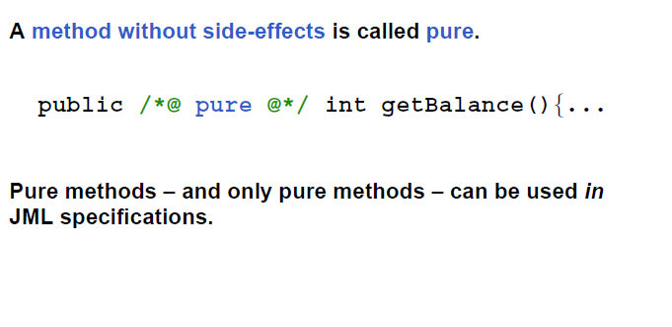
pure

Slide 35
Informal Description
An informal description looks like:
(* some text describing a property *)
It is treated as a boolean value by JML, and
Allows
Escape from formality, and
Organize English as contracts.
public class IMath {
/*@ requires (* x is positive *);
@ ensures \result >= 0 &&
@ (* \result is an int approximation to square root of x *)
@*/
public static int isqrt(int x) { … }
}

Slide 36
Quantifiers
JML supports several forms of quantifiers
Universal and existential (\forall and \exists)
General quantifiers (\sum, \product, \min, \max)
Numeric quantifier (\num_of)
(\forall Student s; juniors.contains(s) ==> s.getAdvisor() != null)
(\forall Student s; juniors.contains(s); s.getAdvisor() != null)

Slide 37
JML recap
The JML keywords discussed so far:
requires
ensures
signals
invariant
non null
pure
\old, code\forall, \exists, \result

Slide 38
Examples
/*@ requires a != null && a.length > 0;
@ ensures (\exists int i; 0 <= i && i < a.length; \result == a[i]) &&
@ (\forall int i; 0 <= i && i < a.length; \result >= a[i]);
@*/
public static int mystery1(int[] a) { /* … */ }
/*@ requires a != null;
@ ensures \result == (\sum int i; 0 <= i && i < a.length; a[i]);
@*/
public static int mystery2(int a[]) { /* … */ }
/*@ requires a != null;
@ ensures \result == (\num_of int i; 0 <= i && i < a.length; x > a[i]);
@*/
public static int mystery3(int a[], int x) { /* … */ }

Slide 39
Outline
Design by contract (DBC)
Java Modeling Language (JML)
DBC with JML
JML tools – JML compiler (jmlc)

Slide 40
Tools for JML
JML compiler (jmlc)
JML/Java interpreter (jmlrac)
JML/JUnit unit test tool (jmlunit)
HTML generator (jmldoc)

Slide 41
JML Compiler (jmlc)
Basic usage
$ jmlc Person.java
produces Person.class
$ jmlc –Q *.java
produces *.class, quietly
$ jmlc –d ../bin Person.java
produces ../bin/Person.class

Slide 42
Running Code Compiled with jmlc
Must have JML’s runtime classes (jmlruntime.jar) in Java’s boot class path
Automatic if you use script jmlrac, e.g.,
$ jmlrac PersonMain

Slide 43
A Main Program
public class PersonMain {
public static void main(String[] args) {
System.out.println(new Person(“Yoonsik”));
System.out.println(new Person(null));
}
}

Slide 44
Example (Formatted)
$ jmlc –Q Person.java
$ javac PersonMain.java
$ jmlrac PersonMain
Person(“Yoonsik”,0)
Exception in thread "main" org.jmlspecs.jmlrac.runtime.JMLEntryPreconditionError
: by method Person.Person regarding specifications at
File "Person.refines-java", line 52, character 20 when
'n' is null
at org.jmlspecs.samples.jmltutorial.Person.checkPre$$init$$Person(
Person.refines-java:1060)
at org.jmlspecs.samples.jmltutorial.Person.<init>(Person.refines-java:51)
at org.jmlspecs.samples.jmltutorial.PersonMain.main(PersonMain.java:27)

Slide 45
Summary: Design by Contract with JML
This document, written by Gary T. Leavens and Yoonsik Cheon, introduces the Java Modeling Language (JML) and explains how it can be used as a Design by Contract (DBC) tool for Java.

Slide 46
Introduction to Design by Contract (DBC)
DBC is a software development methodology where contracts specify the obligations and guarantees between a class and its clients. It uses:
Preconditions (what must be true before calling a method).
Postconditions (what must be true after method execution).
Invariants (conditions that must always hold for an object).
JML integrates these contracts directly into Java code, allowing runtime assertion checking.

Slide 47
Benefits of DBC and
Improved Documentation: JML specifications serve as precise, machine-checkable documentation.
Error Detection and Blame Assignment: Helps pinpoint whether a bug is due to incorrect client usage or a faulty implementation.
Increased Efficiency: Reduces unnecessary defensive programming checks, which can slow down execution.
Modular Reasoning: Developers can understand and verify components based on contracts rather than the entire codebase.

Slide 48
Overview of JML
JML extends Java’s syntax to provide formal behavioral specifications using annotations. It supports:
Preconditions (//@ requires condition;)
Postconditions (//@ ensures condition;)
Class Invariants (//@ invariant condition;)
Quantifiers (\forall, \exists for universal and existential conditions).
JML specifications are placed in Java comments (//@ or /*@ ... @*/), making them compatible with standard Java compilers.

Slide 49
Examples and Features of JML
Formal and Informal Specifications: Developers can write both informal descriptions ((* text *)) and formal contracts.
Information Hiding: Specifications can be public or private to ensure encapsulation.
Model Fields: Abstractions that allow specification without exposing implementation details.

Slide 50
JML Tools
JML comes with a set of tools, including:
JML Compiler (jmlc): Compiles Java with runtime assertion checks.
JML Unit Testing (jmlunit): Integrates with JUnit for automatic contract-based testing.
Documentation Generator (jmldoc): Generates HTML documentation combining Javadoc and JML.
Static Checker (esc/java2): Detects errors like null pointer dereferences before execution.

Slide 51
Installation and Usage
JML is freely available at www.jmlspecs.org. The document provides guidance on installing, compiling, and running JML-annotated Java programs.

Slide 52
Summary
DBC is a way of recording:
Details of method responsibilities
Avoiding constantly checking arguments
Assigning blame across interfaces
JML is a DBC tool for Java
For details on JML, refer to its web page at
www.jmlspecs.org

